Slide 2
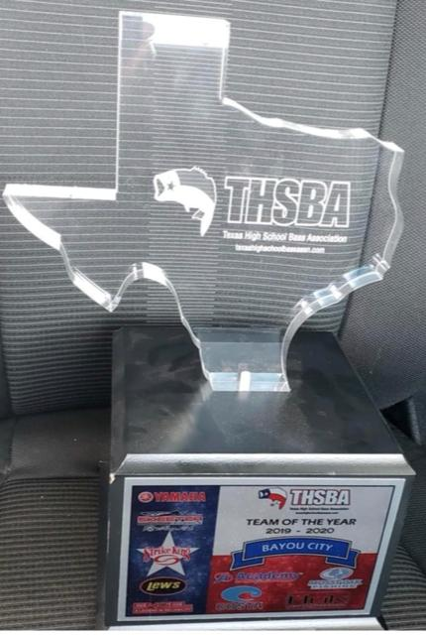
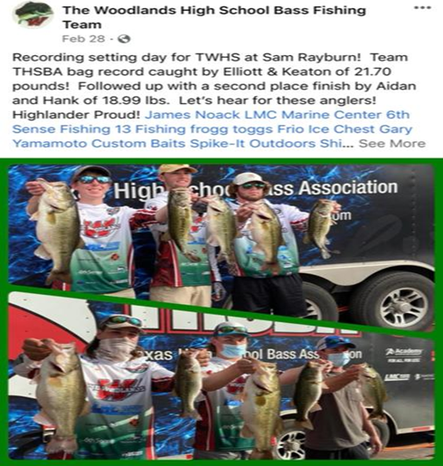
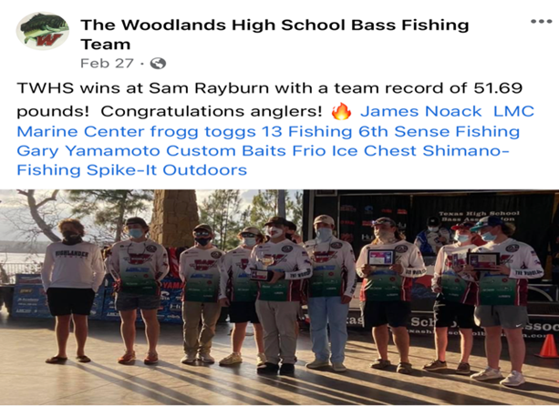
2020/21/22 Accomplishments
The Offshore team fished in 5 regular season tournaments in 2022 and the team won 3 of the 5. The team had a 10 tournament winning streak in place through the 2020-21 seasons.
Individual teams won 1st place in 3 of the 5 regular season tournaments. The team has 15 “Top 10” finishes over the past three seasons
TWHS Offshore team was named “Team of the Year” as THSBA Bayou City Division Champions in 2020, 2021, and 2022!
The team had a record school sack (top 3 bags weighed in) of 58.4 lbs. for the win at Sam Rayburn in March 2022.

Slide 3
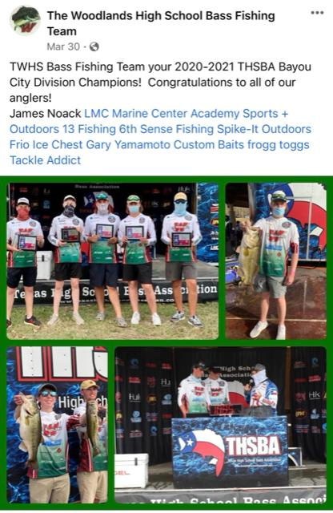
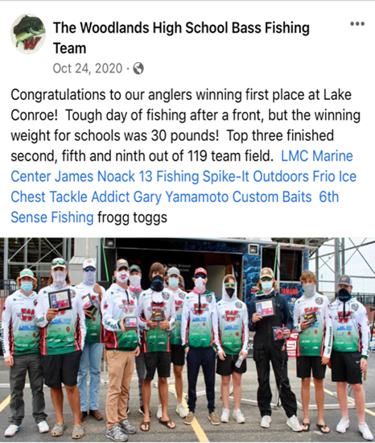
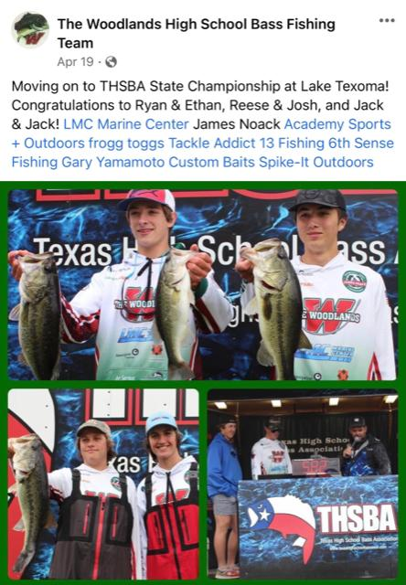
Back to back Y/Y winning history!

Slide 4
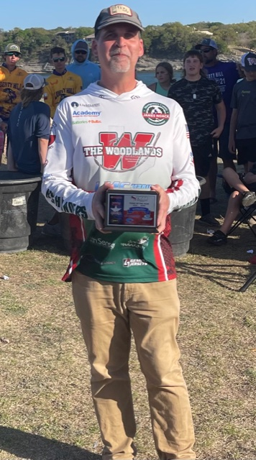
Team History & Expectations

Slide 5
Getting involved Texas High School Bass Association - THSBA
Anglers in 9-12th grades are eligible to participate
TWHS BFT program does not supply boats
Anglers and their families are ultimately responsible for acquiring a boat and boat captain. The Booster club will assist as a clearing house of information on available anglers and captains, but we do not assign teams (varying commitment levels)
Boat teams consist of two anglers and one boat captain. Once registered, teams are set for the season. Substitute boat captains are permitted as long as they meet all requirements.
Teams accumulate points at each event in which they participate. If you change partners mid-season your accumulated points are forfeited.
THSBA Website: http://www.texashighschoolbassassn.com/
Cost to join THSBA is $60 (in addition to your TWHS BFT membership).
Five regular season open tournaments, one regional tournament, one State Championship.
Each tournament cost $60 per team (you pay as a team, if only one team member fishes, it is still $60)
Must fish at least three tournaments to qualify for regionals, however it’s difficult to make regionals if you skip tournaments.
Current point system: points are earned based where you finish, first place receives 500, second 499
Student Anglers must have student ID, Fishing License if 17 and older
Students must be UIL eligible to fish. If you are failing any class at the 9 week period you are UIL ineligible (Only exception is AP classes-must receive waiver). You can become UIL eligible again once all grades are passing at one of the following three week periods.
All offshore anglers must complete a TPWD approved boater safety course to register for the first THSBA tournament.

Slide 6
Offshore Angler Boater Safety Course
The safety and well-being of our offshore fishing anglers is the TWHS Bass Fishing Club’s number one priority. Boat captains and anglers alike have a shared responsibility to be knowledgeable of the rules of boating and environmental conditions while on the water.
All anglers participating in offshore tournaments are required to successfully complete a TPWD approved boater safety course. Anglers must provide a certificate of course completion in order to register for the first THSBA tournament.
A few of the topics that anglers will learn about are: required safety equipment, boat nomenclature, navigation rules and right of ways, markers and buoy’s, emergency protocols, boat handling, etc.
More information about boater safety courses can be found at the following websites:
Texas Parks and Wildlife: https://tpwd.elementlms.com/education/boater-ed/
BoatUS provides a FREE TWPD approved boater safety course online at http://www.boatus.org/texas/
Notes:
6

Slide 7
Key Takeaways
Register with THSBA - $60.00 by Sept 1– will finish State Championship then open back up
Register with TWHSBFT $150.00 - Registration will open over the summer - emails
Anglers complete your BoatUS provides a FREE TWPD approved boater safety course online at http://www.boatus.org/texas/ - good to complete now
Order your team jersey - $75.00 (optional hoodie for an additional $75.00)
Complete your CISD participation physical before the first tournament
Complete your Individual & Boat Captain Release Forms - Completed on THSBA app
Ensure your Boat Captain completes their CISD Background Check – included in registration
For anglers with boats, ensure you have your insurance updated with a minimum of $300,00 in liability
Ensure you have all required items for boat inspection prior to tournament

Slide 8
Boat/Captain Regulations
Must be propeller-driven
Minimum of 16 feet
Must have all required U.S. Coast Guard safety equipment
Maximum speed of tournament day is 60 mph. Maximum 250 hp
Must contain a properly aerated live well space to maintain a five limit of bass
Kill switch and lanyard, navigational Light, throw Cushion, coast Guard rated PFD (Life Jackets) for all on board, fire extinguisher, current TPWD TX numbers, engine Horse Power does not exceed Capacity Plate, and must Carry $300,000 of liability insurance
Boat captains are the only ones permitted to drive boats for their teams
Students can help with loading and unloading only if they have a Boaters Safety Certification
Boat captain must be at least 21 years-old, must have background check completed by CISD
Students may operate the trolling motor

Slide 9
Insurance
TWHS has team insurance purchased from The Bass Federation (TBF)/Student Angler Federation(SAF) in addition to the insurance provided to anglers and boat captains by THSBA and your private boat and liability insurance.
SAF Insurance
Every member and SAF club will have insurance coverage for all official SAF school club events, which includes $1 million of liability coverage, $25,000 Excess Medical Coverage, $1 Million for any allegations of misconduct and $25,000 ‘Amber Alert’ coverage.

Slide 10
Team Captains
Ryan Clarke – Overall Team Captain
Ethan Mitchell
Aidan Casey
Cole Sanders
Ty Collura
Aidan Martinez
Rebecca Comeaux
Athen Hart

Slide 11
THSBA Bayou Division Dates for 2021-22
9.17.22 – Conroe 10.15.22 – Livingston 11.12.22 – Somerville 02.11.23 - Toledo Bend 03.11.23 - Limestone 04.15.23 - Regional Tournament / Conroe 05.20-21.23 - State Tournament / Sam Rayburn

Slide 12
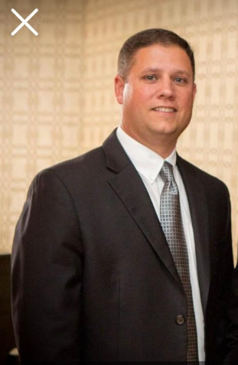
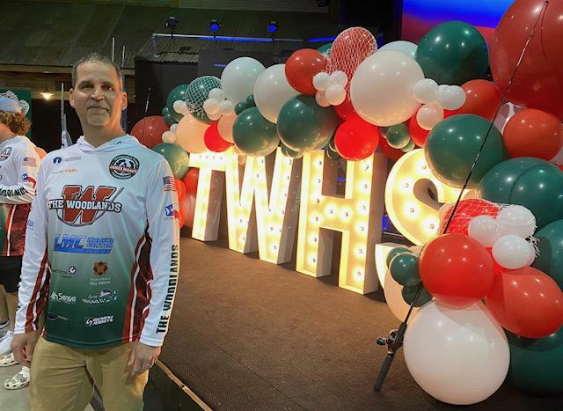
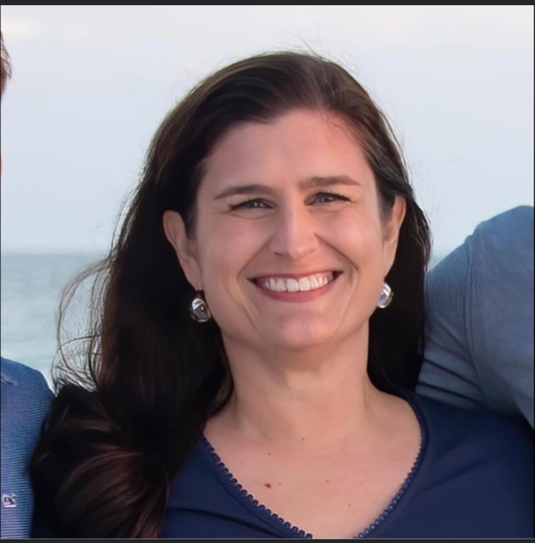
Bass Club Board Members
President – Gary Collura
Vice-President/Coach – Henry Burns
Secretary – Katy Clarke
Treasurer – Kimberly Roth

Slide 13
Volunteer Opportunities
We still need coordinators for:
Offshore Hospitality (arrange for food after tournaments)
Website
Red & Green Parade
Offshore Team Photography
Inshore Team Photography
Yearbook Submissions
Orientation, McC & TWHS

Slide 14
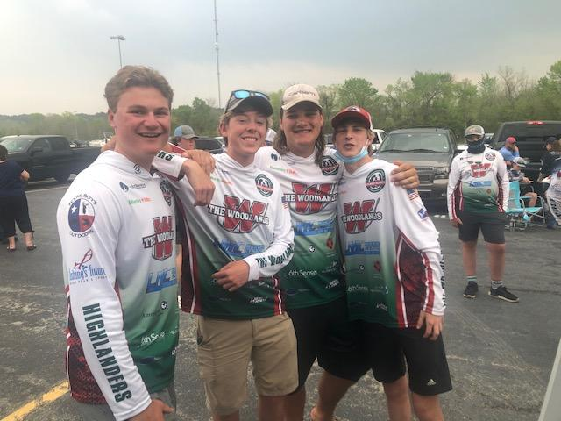
The Woodlands High School Bass Fishing Team
Have fun and catch BIG fish!!!
Go HIGHLANDERS!!!

Slide 15
Expectations - Day of Tournament
Review THSBA Rules and tournament specific itinerary
Double check safety equipment prior to arriving at the lake
All THSBA tournaments are trailering events. There will be a specific start and end time for each event. You must be in the weigh-in line by a certain time or you will be DQ’d.
Get to your selected ramp early to avoid the rush!
Pick up wrist-bands Friday evening or early Saturday morning of the tournament. Anglers must wear wristband during tournament and turn it back in at weigh-in (even if you zeroed). Failure to do so is a DQ and zero points.
Be prepared for bad weather, it usually is… rain suit required
Bring plenty of water, snacks and sunscreen
Take great care of your fish, .5 Lb. deducted for each dead fish.
Measure your fish, short fish will not be weighed in and you will be penalized an additional pound off your remaining weight
Top five teams will have their boat safety equipment checked
First place boat captain will be polygraphed

Slide 16
Offshore Team Tips
In advance, contact each other to discuss the following:
-Time and location to meet prior to launch. Don’t be late!
-Share cost of gas, etc.
-Determine PFD/Life vest needs
-How much gear/tackle each person can bring. There is limited room on the boat
-Determine if anyone is bringing ice to keep fish cool.
-Discuss boat operation (trolling motor, electronics, launching, trailer)
-If distance and hotel are involved, discuss loading, transportation costs.
-Determine if Captain needs help get the boat ready before and after fishing.
-Guests should always offer to help wipe down the boat afterwards.
While on the water:
-Keep gear organized and stowed when not in use as often as possible.
-Don't be careless with lure dyes, drinks, food, stepping in the boat with muddy feet, banging crankbaits off the motor or boat and a reckless style hook set that is hard to control
-Manage trash throughout the day and pick up your trash at the end of the day.
-Make sure you are capable of handling a net, nothing will make a partner more upset than having a co-angler knock a few fish off at the boat.
-When it's time to move make sure you have your rods strapped down and your life jacket/PFD on before the boater is ready to fire up the motor.
-Do your best not to cast on top of or over your boater. Accidents will happen and the wind has a way of picking up in the middle of a cast and taking your cast a little wide right, but just don't cut him off so you can hit a target before he does, unless he tells you to.
-If catching fish on a certain bait and the partner doesn't have one; offer to loan them one if you have enough. You are a team.
-Try not to front end them with the trolling motor. If the wind is out of a direction that just doesn't allow a position for a good angle then offer them a spot on the front deck.
-When you get to a spot where it isn't obvious what we are fishing make sure and fill them in on what it is that you are fishing (for instance if it's a ledge or brush pile, make sure they know that so they can fish accordingly rather than just letting them unknowingly cast out in the middle of nowhere).
-Ask for advice or assistance if needed (line snag) and try to keep unnecessary noise to a minimum.
Captains have the final word on safety, navigation, and pretty much everything. Please respect your captain and their decisions.

Slide 17
Other Offshore Organizations/Trails
B.A.S.S.
Student High School Membership $10 Includes: One Year Membership and One Year subscription to Bassmaster Magazine and B.A.S.S. Tournament Eligibility https://www.bassmaster.com/high-school-bass-fishing
DETX – Deep East Texas B.A.S.S. http://www.outdoorfreedom.net/deep-east-texas-high-school-fishing.html
Grades 7-12, Tournaments held on Sam Rayburn. Cost to join $40 per year, $40 per boat per tournament. Fishing to qualify for BASS National High School Tournament, BASS State High School Championship and more.
Youth Fishing League (YFL) http://www.youthfishingleague.com/ Ages 6-18, $25 to join, $40 per anglers per tournament
SETX – Southeast Texas High School Fishing Association http://www.setxhighschoolfishing.com/
Grades 7-12, $40 entry fee per boat, Fishing Tournaments at Sam Rayburn and Toledo Bend – January – May, Huge events – 500+ boats per tournament
Fishing League Worldwide (FLW) High School https://www.flwfishing.com/tournaments/high-school Series sponsored by Bass Pro Shops
Faith Area Network High School Fishing (FAN) http://faithanglernetwork.com/ Grades 7-12, $10 to join FAN, $40 entry fee per boat
Central Texas High School https://www.cthstt.com/ Grades 6-12. $40 entry fee per boat

Slide 18
Other Offshore Organizations/Trails
The Bass Federation (TBF)/Student Angler Federation(SAF)
Tournaments – No entry fee to members
State Championships –> Conference Championships –> Nationals
The high school fishing program starts with a State Championship in every participating state in the US and Ontario, Canada. High school students in grades 9-12 compete in two person teams with a boat captain. All state championships are no entry fee for active SAF members. The winning team from each state championship advances to a Conference Championship. The winning team from each conference championship advances to the High School Fishing National Championship to compete for a $10,000 scholarship to use at the university of their choice.
High School Fishing World Finals
All SAF members and High School Fishing State Championship contestants automatically qualify for High School Fishing’s single largest event, the High School Fishing World Finals. All SAF members who have graduated the 8th grade and not yet started college (9-12) who meet the minimum requirements are eligible to enter and fish the High School Fishing World Finals in July. The HSFWF is High School Fishing’s premier open event.
ADDITIONAL BASS FISHING TOURNAMENTS http://www.basstournamentfinder.com/
Annual High School Tournaments
Texas State Bass Tournament http://www.texasstatebass.com/
Jim Brockman Youth Open http://www.youthfishingleague.com/jbyo2018.html
The Texas Fallen Heroes H.S. Fishing Championship http://www.outdoorfreedom.net/texas-fallen-heroes-championship.html
National Lake Fork High School Open http://lakeforkchamber.org/lakeforkopen.html
Local Bass Clubs (anglers under 18 need to be sponsored by an adult/parent)
The Woodlands Bass Club www.thewoodlandsbassclub.org
Seven Coves Bass Club www.sevencovesbassclub.com
Tuesday night tournaments at Lakeview Marina on Lake Conroe
Sunday Morning tournaments held at Stow-A-Way Marina on Lake Conroe

Slide 19
THSBA Registration
Cost to join TWHS BFT $150
Cost to join THSBA $60
Team Jersey $75 (optional hoodie $75)
Boater Safety Certification
CISD Participation Physical
Individual & Boat Captain Release Forms
Boat Captain CISD Background Check

Slide 20
The Woodlands High School Bass Fishing Team
Welcome to Offshore Fishing!
Boat Tournament Information
2022-23

